Slide 1

Cache Design
Part 1 of 2
Overview and Operation
Temporal and Spatial Locality
Cache Architecture
Direct Mapped
Fully Associative
Set Associative
Note: After today, please read lectures 25A and 25B on Canvas
©Paul Davies. Not to be copied, used, or revised without explicit written permission from the copyright owner.
This lecture may contain animations and is best viewed as a slide show

Slide 2
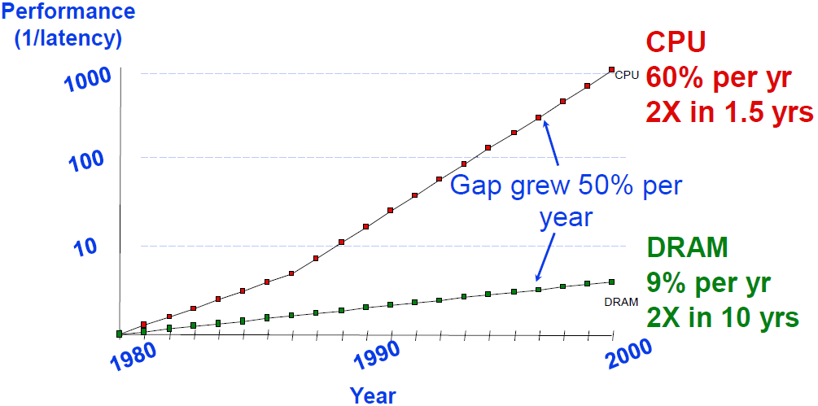
The Need for CPU Caches
We saw in Lectures 9-11 that since the 80’s, the speed of CPUs has become dramatically faster than main memory based on Dram technology. In fact it would be pointless running a multi Giga-Hertz processor directly from Dram today, as there would be so many wait states incurred the performance would be appalling

Slide 3
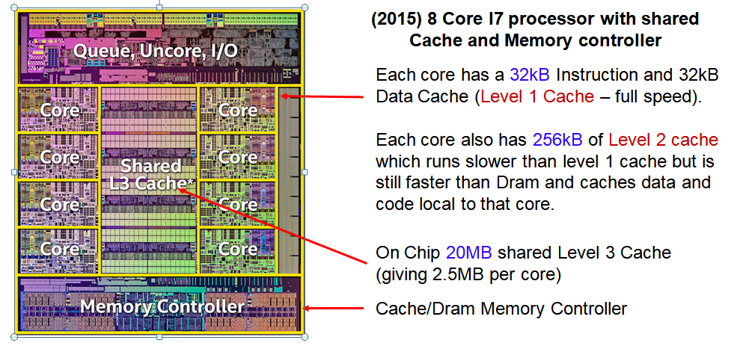
The Need for CPU Caches
For this reason most fast CPUs/cores have some kind of cache memory that will provide a high speed “copy” of the most recently accessed dram data.
That is, when the CPU accesses an address in Dram (which will be slow), a copy of that data will also be stored in the cache memory if needed again in the future.
Our 68k processor is limited to 25MHz because, without a cache, this is the maximum speed the processor could run from Dram without incurring wait states.

Slide 4
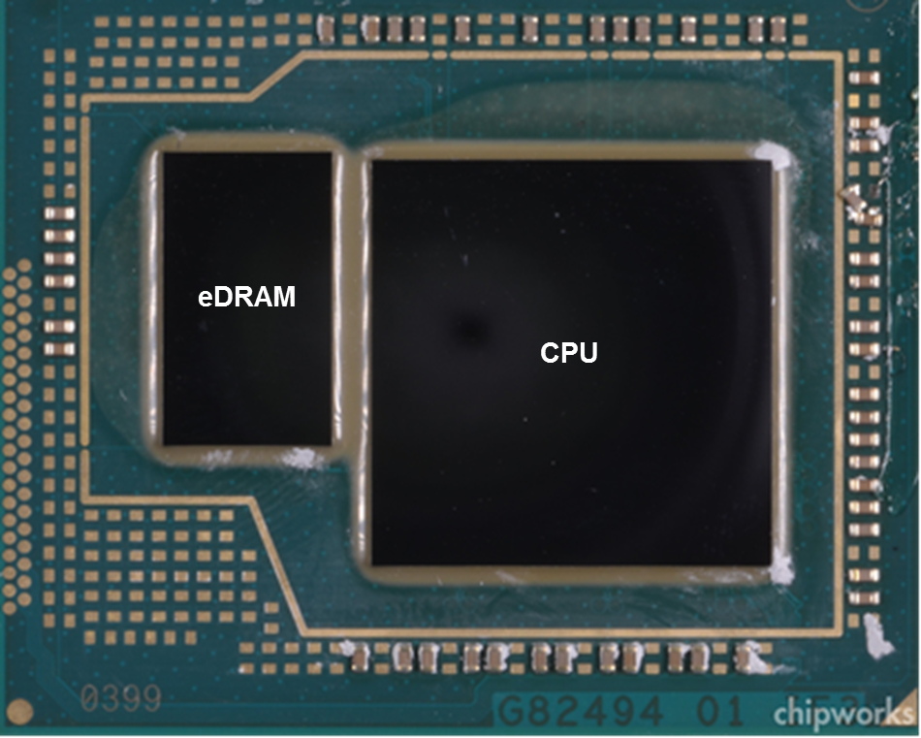
Intel “Haswell” I7 has a 128Mbyte Level 4 cache based on embedded Dram inside the package

Slide 5
Separate vs Unified Caches

Slide 6
Most modern CPUs such as the i7 have separate cache memories. One for holding data the other for holding instructions so that program data and program op-codes do not compete for storage within a single cache.
Separate caches allow the operation and physical size of the cache to be optimised differently for data vs. instructions. It also permits simultaneous access to both caches to support pipelining, e.g. instruction fetch while at the same time as reading/writing data.
RISC processors based on the Harvard architecture e.g. ARM, NIOS, utilise separate Data and Instruction caches
Some CPUs however may elect to use a unified cache where instructions and data compete for space inside one single cache.

Slide 7
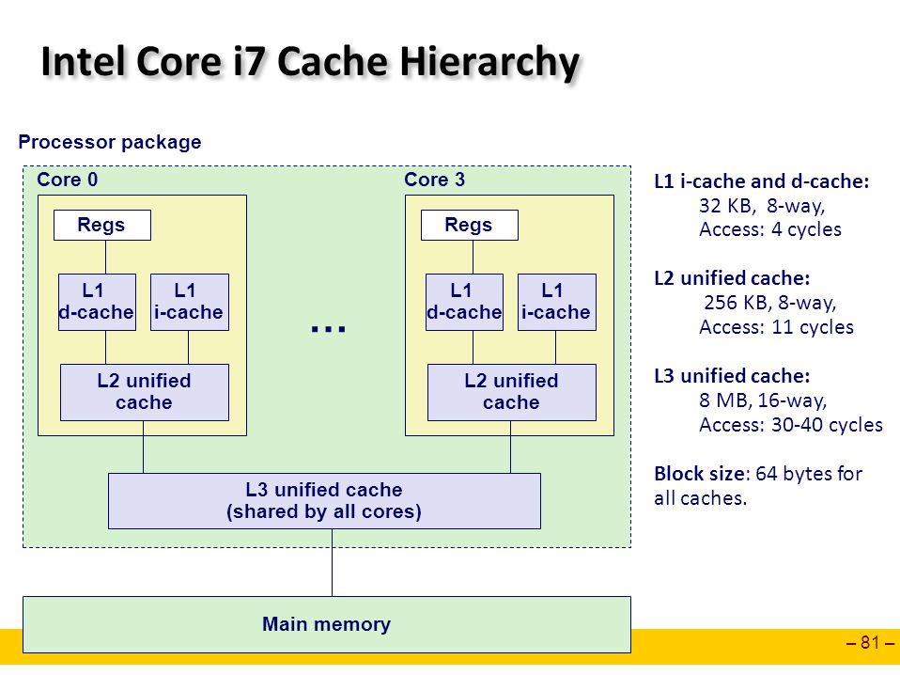
Intel i7, has separate level 1 Instruction/Data caches. Level 2 and 3 caches are unified.
Note the speed difference between the 3 levels of cache: Between 4 and 40 clocks.
The difference in speeds reflect the fact that Level 1 caches are usually based on physically large Sram cells (faster read), Level 2 use smaller cells (optimised for density) and Level 3 may use Sram or Dram (optimised for extreme density/lower speed).
Main memory (Dram) accesses are even slower than those, perhaps 100’s of clocks to access one dram location using a CPU running at GHz+ processor speeds.
Main memory 100+ cycles

Slide 8
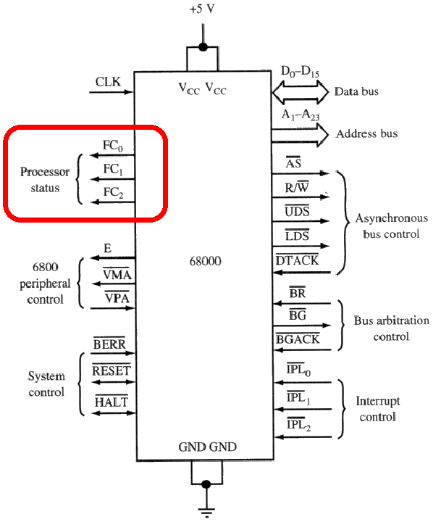
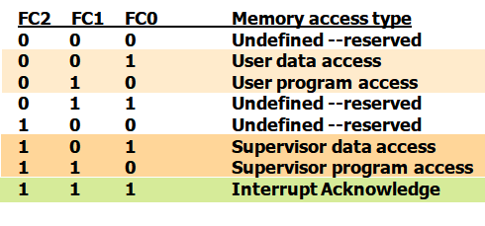
68k Cache interface signals
Special signals are needed to interface a CPU to a cache controller to indicate if the CPU is accessing program code (instructions) or data. This would facilitate the design of separate Instruction and Data caches
The original 68k had these signals called FC₂ - FC₀, however our soft core 68k does not have them, so we will adopt a unified approach for our upcoming assignment.

Slide 9
Basic Cache Operation

Slide 10
Basic Cache Operation
Suppose the CPU requests a program instruction or perhaps program data.
Initially that data resides only in main memory, i.e. Dram, (which can actually be thought of as a cache for the disk).
That data will have to be brought in from the slower (dram) memory, by a cache controller, before being given to the CPU to process. As per Page 7, this could take 100’s clock cycles and many wait states will be incurred.
After the data is brought in, a copy of it would then be stored in the appropriate cache memory (Data or Instruction).
If sometime in the future, the CPU were to ask for that same instruction or data again, the cache memory could supply it much faster, speeding up program execution and “hiding” the penalty of a slow main memory.
The likelihood of this repeat request occurring is significant due to temporal and spatial locality of data (https://en.wikipedia.org/wiki/Locality_of_reference ).

Slide 11
Temporal and Spatial Locality

Slide 12
Temporal Locality:
Given that many programs spend their time executing within small loops, there is a strong probability that any instruction or variable accessed once, will be accessed again fairly soon, i.e. repeat requests, close in time. e.g.
for(i = 0; i < n; i ++)
array[i] = array[i+1] + array[i+2]
A good cache controller would arrange to store a local copy of ‘i’ as well as ‘n’ and the 3 items of data read from ‘array’ to speed up access to those variables if they are used again with the loop execution.
Likewise the machine code instructions inside that loop could be cached for improved speed 2nd time around the loop
'i‘ accessed over and over again within short period of time

Slide 13
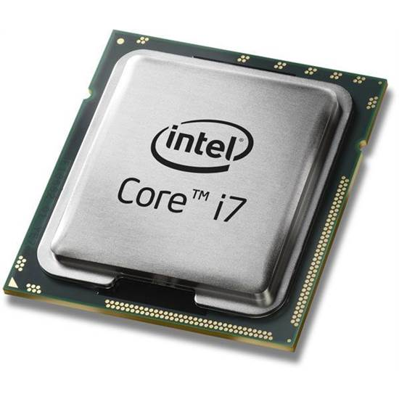
Spatial Locality:
Likewise given the mostly sequential nature of compiled programs (i.e. machine code), if an instruction or variable is fetched from main memory, there is a strong probability that the next ‘n’ instructions or variables (particularly in the case of say an array) will also be accessed fairly soon.
Sequential ‘C’ Code
Assembly Code
Machine Code
push %rbp
mov %rsp,%rbp
sub $0x10,%rsp
movl $0x0,-0x4(%rbp)
cmpl $0x9,-0x4(%rbp)
jg 40084d <main+0x37>
mov -0x4(%rbp),%eax
mov %eax,%esi
mov $0x601060,%edi
callq
mov $0x400700,%esi
mov %rax,%rdi
callq 4006f0
addl $0x1,-0x4(%rbp)
jmp 400825 <main+0xf>
mov $0x0,%eax
leaveq
retq
55
48 89 e5
48 83 ec 10
c7 45 fc 00 00 00 00
83 7d fc 09
7f 22
8b 45 fc
89 c6
bf 60 10 60 00
e8 66 fe ff ff
be 00 07 40 00
48 89 c7
e8 a9 fe ff ff
83 45 fc 01
eb d8
b8 00 00 00 00
c9
c3
#include <stdio.h> int main(void)
{ for (int i=0; i < 10; ++i) { printf(“%d\n”, i); } return 0; }
55
48
89
e5
48
83
ec
10
c7
Cache controller might load all these instructions into cache memory as soon as push %rbp instruction fetched

Slide 14
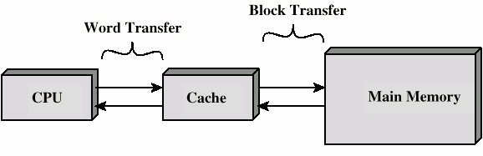
Supporting Spatial Locality : Burst Cache Transfers
In attempting to predict the CPU’s next access, a good cache controller will attempt to transfer a large block of data or instructions in anticipation of them being needed soon, e.g. the next ‘n’ instructions or the next ‘n’ elements in an array.
To support this block transfer, Synchronous Drams have a “burst data” mode specifically designed to enable a cache controller to transfer a block from main memory to cache memory, as quickly as possible.

Slide 15
Direct Mapped
Cache Architectures

Slide 16

Incoming CPU address split into Tag + Index (Cache Line) + Word (Cache Column). Note no A0 on 68k
CPU Address (showing bit positions)
31 30 29 . . . . . 9
8 . . . . 4
3 2 1
Tag Address
Index
Word
Note multiple cache lines storing multiple items of data e.g. 2, 4, 8, 16 words etc.
23
5
3
Tag
Index
Index + Word
+
Index
0
1
2
. . . . . . . . .
. . .
29 30 31
Valid
Tag Data
8
Cached Data: 8 words per Line
0
0
0
0
32 Cache Lines of
8 x 16 bit Words =
512 bytes
0
0
0
0
0
0
Tag In
Tag Out
16
=
CPU Data
Tag data stores most significant bits of address in main memory where the first item of data in the line is stored
Validity Bit indicates a loaded/empty line.
Hit

Slide 17
Address bits [8..4] select 1 of 32 lines.
Address bits [3..1] select 1 of 8 words in a line.
Address bits [31..9] stored as Tag Data for each line during fill to identify where the line data is stored in dram
Any CPU address always maps directly to one word within one line of the cache.
CPU Address (showing bit positions)
31 30 29 . . . . . 9
8 . . . . 4
3 2 1
Tag Address
Index
Word
23
5
3
Tag
Index
Index + Word
+
Index
0
1
2
. . . . . . . . .
. . .
29 30 31
Valid
Tag Data
8
Cached Data: 8 words per Line
0
0
0
0
32 Cache Lines of
8 x 16 bit Words =
512 bytes
0
0
0
0
0
0
Tag In
Tag Out
16
=
CPU Data
Hit

Slide 18
Cache Hits and Misses
During a CPU read, bits [8..4] select a Line. If that Line is valid, the CPU address bits [31..9] are compared to the address stored in the Tag Data for that line and if the addresses match “a hit”, the cache line supplies a word, to the CPU otherwise (a “miss”) the data is brought into the cache from main memory and given to the CPU.
CPU Address (showing bit positions)
31 30 29 . . . . . 9
8 . . . . 4
3 2 1
Tag Address
Index
Word
23
5
3
Tag
Index
Index + Word
+
Index
0
1
2
. . . . . . . . .
. . .
29 30 31
Valid
Tag Data
8
Cached Data: 8 words per Line
0
0
0
0
32 Cache Lines of
8 x 16 bit Words =
512 bytes
0
0
0
0
0
0
Tag In
Tag Out
16
=
CPU Data
Hit

Slide 19
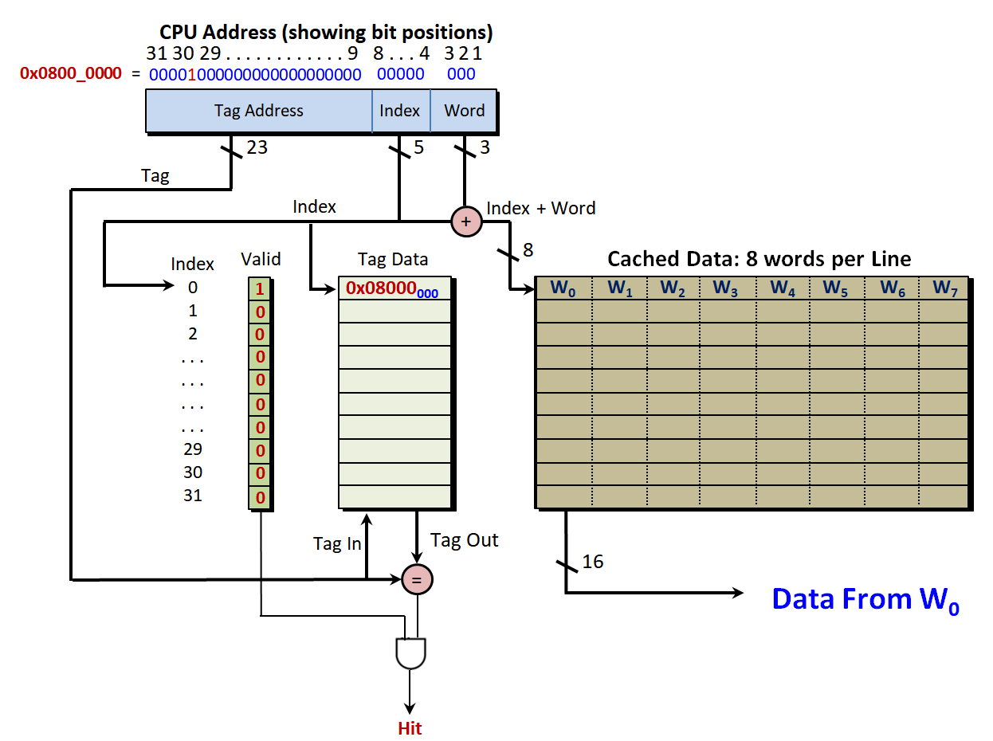
Assume cache is empty and the CPU attempts to read from address 0x0800_0000?
Line 0 is selected but the Valid bit shows a “miss”. 8 words of data are burst into line 0 from dram and the requested word W₀ is given to the CPU.
The Valid bit and Tag data are updated.
CPU Address (showing bit positions)
31 30 29 . . . . . . . . . . . . 9
8 . . . 4
3 2 1
0x0800_0000 =
00001000000000000000000
00000 000
Tag Address
Index
Word
Tag
23
5
3
Index
+
Index + Word
Index
0
1
2
. . . . . . . . .
. . .
29 30 31
Valid
Tag Data
8
Cached Data: 8 words per Line
1
0x08000₀₀₀
W₀ W₁ W₂ W₃ W₄ W₅ W₆ W₇
0
0
0
0
0
0
0
0
0
Tag In
Tag Out
=
16
Data From W₀
Hit

Slide 20
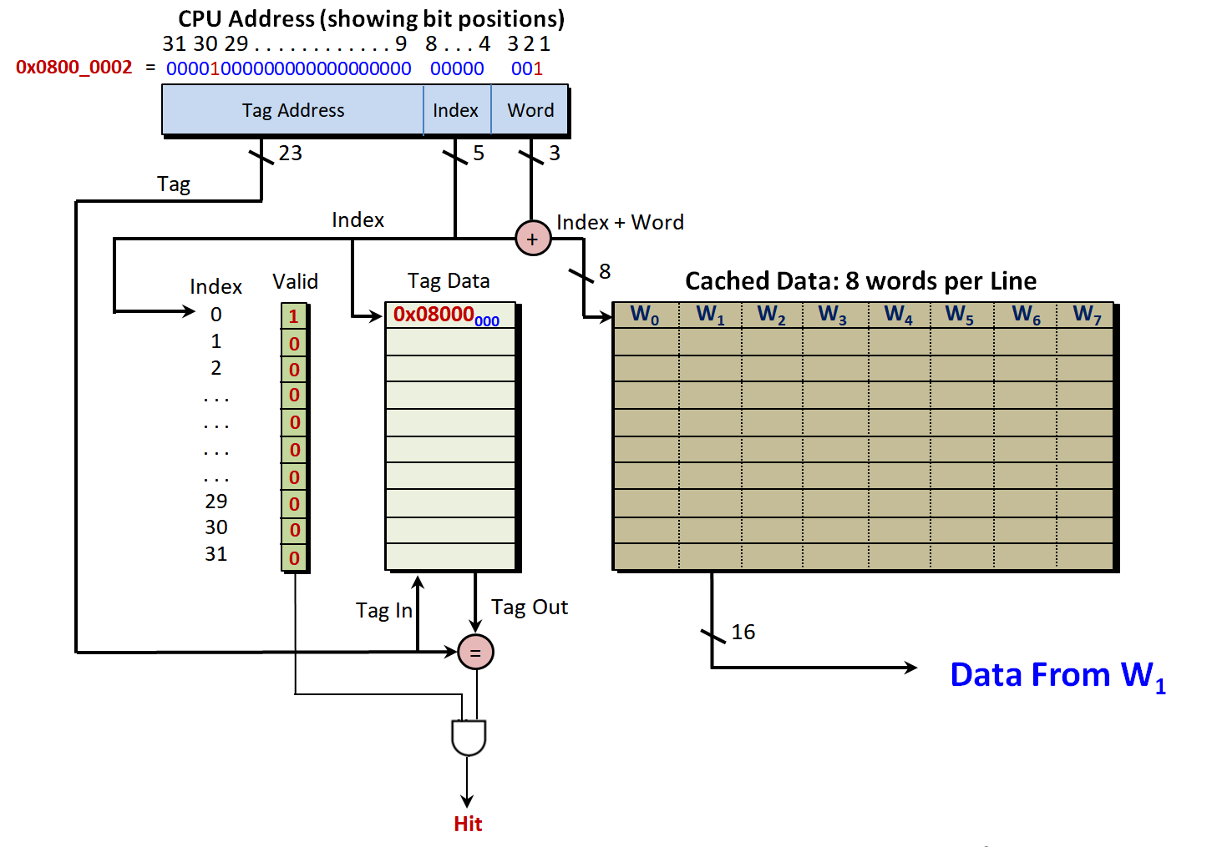
What happens if the CPU now attempts to read from address 0x0800_0002?
Line 0 is again selected and the Valid bit and Tag data indicate that the requested word is in the cache (from the previous burst read at location 0x0800_0000). A hit occurs and the data from W₁ in Line 0 is given to the CPU without any need to access main memory i.e. faster.
CPU Address (showing bit positions)
31 30 29 . . . . . . . . . . . . 9
8 . . . 4
3 2 1
0x0800_0002 =
00001000000000000000000
00000 001
Tag Address
Index
Word
Tag
23
5
3
Index
+
Index + Word
Index
0
1
2
. . . . . . . . .
. . .
29 30 31
Valid
Tag Data
8
Cached Data: 8 words per Line
1
0x08000₀₀₀
W₀ W₁ W₂ W₃ W₄ W₅ W₆ W₇
0
0
0
0
0
0
0
0
0
Tag In
Tag Out
=
16
Data From W₁
Hit

Slide 21
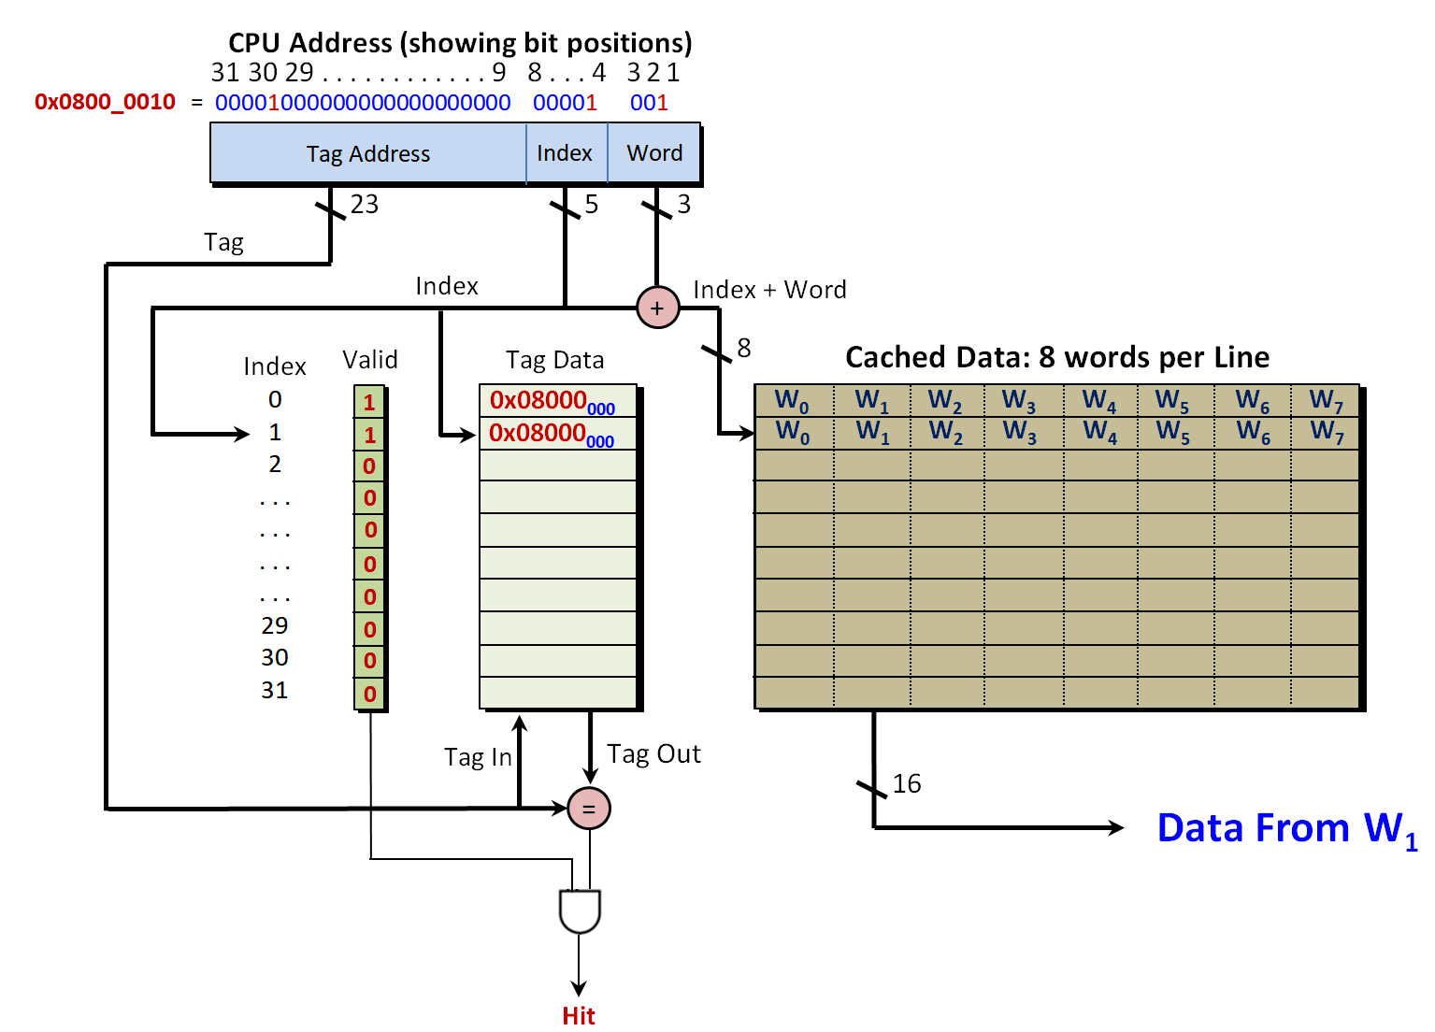
What happens if the CPU now reads a word from address 0x0800_0012?
Answer: Bits [8..4] of the CPU address 0x0800_0012 select Line 1. That line is invalid, so a burst read of 8 words is initiated, starting at dram base address 0x08000_0010.
Once filled, data from Line 1:W1 is given to the CPU. The cache now looks like this.
CPU Address (showing bit positions)
31 30 29 . . . . . . . . . . . . 9
8 . . . 4
3 2 1
0x0800_0010 =
00001000000000000000000
00001 001
Tag Address
Index
Word
Tag
23
5
3
Index
+
Index + Word
Index
0
1
2
. . . . . . . . .
. . .
29 30 31
Valid
Tag Data
8
Cached Data: 8 words per Line
1
0x08000₀₀₀
W₀ W₁ W₂ W₃ W₄ W₅ W₆ W₇
1
0x08000₀₀₀
W₀ W₁ W₂ W₃ W₄ W₅ W₆ W₇
0
0
0
0
0
0
0
0
Tag In
Tag Out
=
16
Data From W₁
Hit

Slide 22
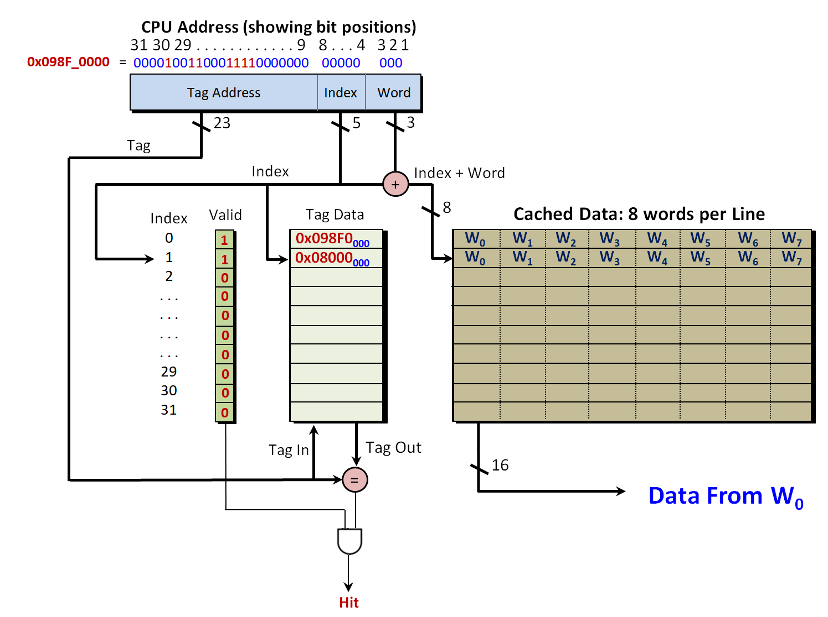
Assume CPU now reads from address 0x098F_0000. Bits [8:4] of the address = {00000} and thus Line 0 is selected. This line is currently full of data from memory location 0x0800_0000.
The CPU address bits [31..9] are compared with the Tag address in Line 0 and a MISS occurs,
A new burst is initiated and Line 0 is filled with new data and the Tag address updated.
CPU Address (showing bit positions)
31 30 29 . . . . . . . . . . . . 9
8 . . . 4
3 2 1
0x098F_0000 =
00001001100011110000000
00000 000
Tag Address
Index
Word
Tag
23
5
3
Index
+
Index + Word
Index
0
1
2
. . . . . . . . .
. . .
29 30 31
Valid
Tag Data
8
Cached Data: 8 words per Line
1
0x098F0₀₀₀
W₀ W₁ W₂ W₃ W₄ W₅ W₆ W₇
1
0x08000₀₀₀
W₀ W₁ W₂ W₃ W₄ W₅ W₆ W₇
0
0
0
0
0
0
0
0
Tag In
Tag Out
=
16
Data From W₀
Hit

Slide 23
Limitation of Direct Mapped Caches: Clashes and Evictions
It’s easy to see that with a direct mapped cache, any access to main memory where address bits [8..4] = {0,0,0,0,0} , i.e. the address bits that select a line, compete to use Line 0 in the cache. When a cache “clash” occurs, i.e. a line needs to be re-used, then old data in the line must be evicted to make space for new data.
For example, these 4 addresses 0x08000000, 0x08000200, 0x08000400, 0x08000800 as well as many others will always share/map directly to Line 0 in this particular cache architecture and size – can you see why?
Cache Thrashing
If the CPU spent its time alternating between reads of the above 4 addresses, then cache thrashing would occur, as each access would attempt to initiate a burst read to overwrite the data brought into the cache by the previous access.
As a result, performance would be very poor, in fact it would probably be worse than if no cache existed at all, since a burst fill could well take longer than just a regular read of one item of data from dram, particularly if the number of words in a burst/line is large. In reality the probability of this occurring is very low, but it does explain why some programs can perform very badly with certain types of cache, data and algorithms.

Slide 24
With more lines, cache eviction could be reduced e.g. a 512 line/8KByte cache. Notice how the CPU address bits [12:4] are now needed to select 1 of the 512 lines.
Class Question: How does this new sized cache reduce thrashing when alternating between reads from 0x08000000 and 0x08000200? Which line would hold the data? (Think about the values of the individual address bits)
CPU Address (showing bit positions)
31 . . . . . . . . 13
12 . . . . 4
3 2 1
Tag Address
Index
Word
19
9
3
Tag
Index
+
Index + Word
Index
0
1
2
. . . . . . . . .
. . .
509 510 511
Valid
Tag Data
12
Cached Data: 8 words per Line
0
0
0
512 Cache Lines of 8 Words = 8192 K Words i.e. needs 12 address lines
0
0
0
0
0
0
0
Tag In
Tag Out
=
16
CPU Data
Hit

Slide 25
Fully Associative
Cache Architecture

Slide 26
Fully Associative Caches
To reduce evictions and competition for a line, a fully associative cache can use any line in the cache to hold data from Dram. When more data is needed we simply use another free line. The need to evict data from a line only occurs when the cache becomes full and we need space to load new data.
The problem with a fully associative cache, is that it is very expensive to implement. Instead of 1 “hit” comparator acting for all lines in the cache, a comparator is needed for every line and a parallel search to find the line with the data needs to be conducted – which can be slow (lots of logic).
The state machine that ultimately controls the cache also becomes more complex as its placement algorithm needs to locate unused lines and it’s replacement algorithm has to choose lines to evict when it gets full.

Slide 27
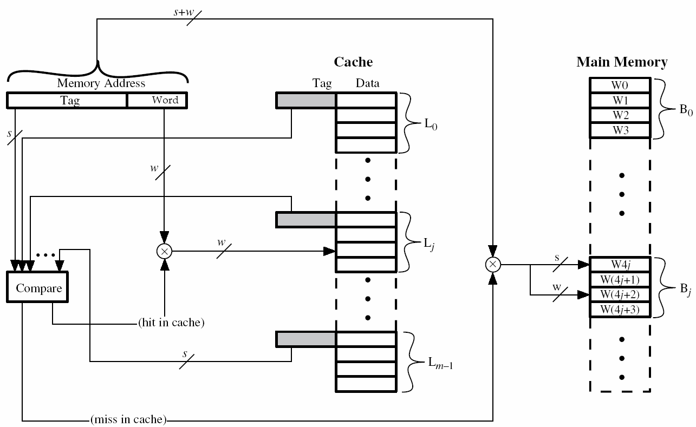
Example Fully Associative Cache architecture with ‘M’ lines
Data can be loaded into any line. Complex allocation and replacement algorithm
Multiple M-Bit wide comparators needed to generate ‘M’ separate Hit/Miss signals.
Complex MUX needed to get the data from a word in one of the M lines
Cache
Main Memory
V
Line ₀
V
Data Mux
Line _{J}
External Fetch
Line Number
V
Line _{M - 1}

Slide 28
Set Associative
Cache Architecture

Slide 29
Set Associative Caches
These offer a compromise between the flexibility and performance offered by a fully associative cache, and the simplicity of a direct mapped cache.
With a 2 way “set associative” cache, each CPU address maps to two possible lines in the cache memory. A cache controller, finding that one of those lines is currently occupied, could load new data into the 2nd line to avoid evicting the first, thus increasing subsequent hit rates and reducing the likelihood of cache thrashing.
With a 4 way “set associative” cache, each CPU address maps to four possible lines in the cache memory, further reducing the need to evict data and thrashing. In fact it could be designed as 4 separate direct mapped caches working together (see next slide).
A “direct mapped” cache is thus a special case of a 1 way set associative cache where data can only be loaded into precisely 1 line in the cache.

Slide 30
CPU Address Bus
A 4-Way Set Associative Cache: 4 Sets x 32 Lines x 8 Words = 2 K Bytes
31 30 29 . . . . . 9
8 . . . . 4
3 2 1
Tag Address
Index
Word
Block 0 Write Signals (from State machine)
Block 1 Write Signals (from State machine)
Block 2 Write Signals (from State machine)
Block 3 Write Signals (from State machine)
23
5
Block 0
Block 1
Block 2
Block 3
Index
0
1
2
. . . . . . . . .
. . .
29 30 31
V
Tag
Data
V
Tag
Data
Tag
Data
V
Tag
Data
0
0
0
0
0
0
0
0
Set of 4 lines spread across 4 blocks
0
0
0
0
0
0
0
0
0
0
0
0
0
0
0
0
0
0
0
0
0
0
0
0
0
0
0
0
0
0
0
0
=
=
=
=
Tag
V [0]
Hit [0]
V [1]
Hit [1]
V [2]
Hit [2]
V [3]
Hit [3]
Used on many advanced CPUs: ARM, x86 etc. Still more complex than Direct Mapped, but simpler than Fully associative.
D0
D1
D2
D3
Hit [0..3]
4 Way - 16 bit Mux
16
CPU Data

Slide 31
Read Operation - Hit
During a CPU read, the index is presented to all 4 blocks and each would search for the data. In the case of a hit, a 4-way Mux supplies the word from that block.
CPU Address Bus
A 4-Way Set associative Cache: 4 Sets x 32 Lines x 8 Words = 2 K Bytes
31 30 29 . . . . . 9
8 . . . . 4
3 2 1
Tag Address
Index
Word
Block 0 Write Signals (from State machine)
Block 1 Write Signals (from State machine)
Block 2 Write Signals (from State machine)
Block 3 Write Signals (from State machine)
23
5
Block 0
Block 1
Block 2
Block 3
Index
0
1
2
. . . . . . 29 30 31
V
Tag
Data
V
Tag
Data
Tag
Data
V
Tag
Data
0
0
0
0
0
0
0
0
0
0
0
0
0
0
0
0
0
0
0
0
0
0
0
0
0
0
0
0
0
0
0
0
0
0
0
0
0
0
0
0
=
=
=
=
Tag
V [0]
Hit [0]
V [1]
Hit [1]
V [2]
Hit [2]
V [3]
Hit [3]
D0
D1
D2
D3
Hit [0..3]
4 Way 16 bit Mux
16
CPU Data

Slide 32
Read Operation - Miss
If a miss occurs. The Valid bits V[3]..V[0] indicate which block/line combinations are free and a Cache Controller chooses an empty block to fill. If no free blocks, then evict one
CPU Address Bus
A 4-Way Set associative Cache: 4 Sets x 32 Lines x 8 Words = 2 K Bytes
31 30 29 . . . . . 9
8 . . . . 4
3 2 1
Tag Address
Index
Word
Block 0 Write Signals (from State machine)
Block 1 Write Signals (from State machine)
Block 2 Write Signals (from State machine)
Block 3 Write Signals (from State machine)
23
5
Block 0
Block 1
Block 2
Block 3
Index
0
1
2
. . . . . . . . .
. . .
29 30 31
V
Tag
Data
V
Tag
Data
Tag
Data
V
Tag
Data
0
0
0
0
0
0
0
0
0
0
0
0
0
0
0
0
0
0
0
0
0
0
0
0
0
0
0
0
0
0
0
0
0
0
0
0
0
0
0
0
=
=
=
=
Tag
V [0]
Hit [0]
V [1]
Hit [1]
V [2]
Hit [2]
V [3]
Hit [3]
D0
D1
D2
D3
Hit [0..3]
4 Way 16 bit Mux
16
CPU Data

Slide 33
CPU Address Bus
A 4-Way Set associative Cache:4 Sets x 32 Lines x 8 Words = 2 K Bytes
Shows data loaded from address 08000000 – 0800000F and 098F0000 – 098F000F
Compare with Direct Mapped Solution (page 22) where a clash/eviction would occur.
31 30 29 . . . . . 9
8 . . . . 4
3 2 1
Tag Address
Index
Word
23
5
Block 0
Block 1
Block 2
Block 3
Index
0
1
2
. . . . . . . . .
. . .
29 30 31
V
Tag
Data
V
Tag
Data
Tag
Data
V
Tag
Data
1
0x08000₀₀₀
1
0x098F0₀₀₀
0
0
0
0
0
0
0
0
0
0
0
0
0
0
0
0
0
0
0
0
0
0
0
0
0
0
0
0
0
0
0
0
0
0
0
0
0
0
=
=
=
=
Tag
V [0]
Hit [0]
V [1]
Hit [1]
V [2]
Hit [2]
V [3]
Hit [3]
D0
D1
D2
D3
Hit[0..3]
4 Way 16 bit Mux
16
CPU Data

Slide 34
Cache Control
Many real world cache controllers have a cache control register that the CPU can write to, to request the cache perform certain tasks. These include
Cache Invalidating – Invalidating a cache simply marks all the cache lines as invalid. This is often done after a power-on or reset.
Cache Flushing - Flushing a cache simply means writing back the contents of the cache to main memory (if contents have changed). This is frequently used with “data” caches and may be invoked by an OS between task swaps.
Cache Locking – it may sometimes be advantageous to lock the contents of a cache in place so that its contents cannot be evicted. The idea here is perhaps to avoid cache thrashing and when it is known that an algorithm will perform better if certain data/instructions are always in the cache.
Cache By-Pass – Addresses are identified by the cache controller as “by-passing” the cache. Important for IO devices and for shared memory in multi-processor systems.

